Slide 1
Almost Grads
Watson Weather Service
Holland Clarke, John Herwig, Luke Swint

Slide 2
Our Idea
Weather Service with Watson Assistant and OpenWeatherMap API
Pass a city/state or city/country to the API, get weather response
Provide information to users via chatbot on web app (node.js)
Next steps: Finish weather features
Allow users to choose city
Next steps: Add other features
Flight API for travelling to destinations with sunny forecast
Recommend restaurants nearby based on weather conditions
Provide local news articles

Slide 3
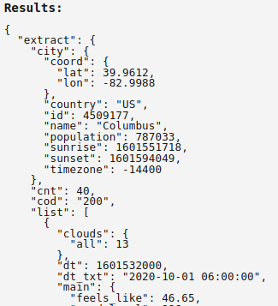
OpenWeatherMap API
With a city OR city and state OR city and country, the API responds with a JSON file that includes:
Sunset, temperature, population, etc.
Sunrise/sunset in unix timestamp
Example response from IBM Cloud Functions -->

Slide 4
Struggles
What we wish we knew before this week:
That we could use a webhook for the API and the web chat integration feature
We thought we’d have to build our own front-end to show the text to and from Watson
What we are struggling with right now
Sending a city to the OpenWeatherMap API from the user
Adding logic to display sunrise/sunset properly

Slide 5
What We Have to Show
Working website deployed to Heroku
Chatbot that can currently provide limited info for Columbus, OH
What we want to Provide for the next timebox:
User can specify city - city can be saved as variable
Maybe ask for users’ location
User can find more information than just weather info
Flights, restaurants or news added

Slide 6
DEMO

